Slide 1
Favour City Ibusa, Asaba
WHY YOU SHOULD INVEST

Slide 2
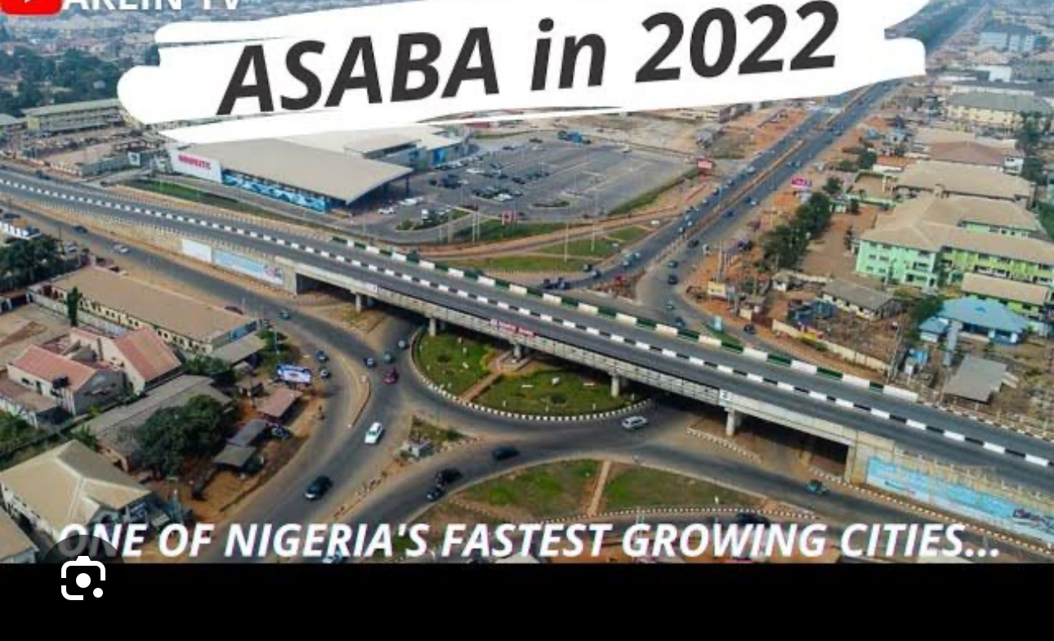
1. BOOMING DEVELOPMENT:
Asaba is rapidly expanding with new shopping malls, modern infrastructural projects. You will be amazed at the level of development and expansion.

Slide 3
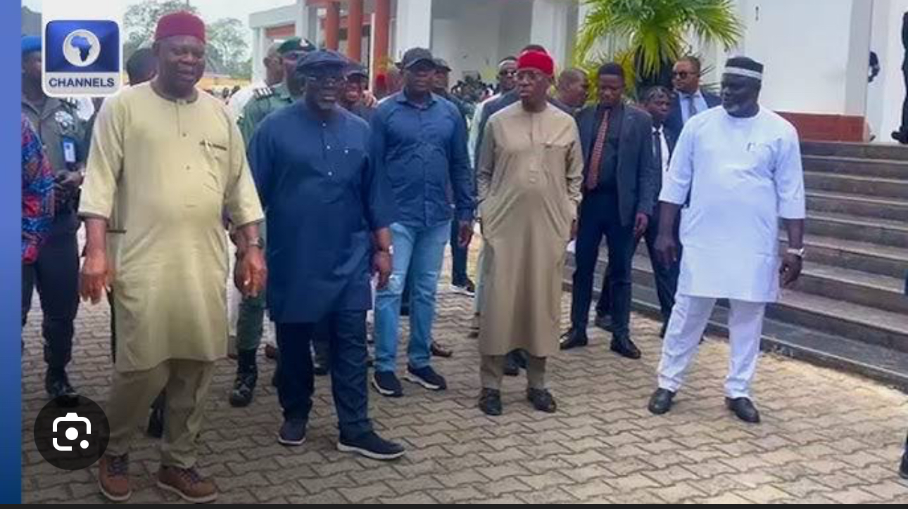
2. Political Stability:
One of the agendas of the previous and present administration of the state is infrastructural development. The current administration under the leadership of His Excellency Hon, Sheriff Oborevwori has continued the previous construction projects left behind by his predecessor Dr. Ifeanyi Okowa.
The political stability has increased real estate activities in the state’s capital as governmental policies aimed at improving infrastructural development in the state

Slide 4
3. Growing Population:
The thriving economy in Asaba has attracted job seekers, traders and new businesses which has increased it’s population from about 149,000 in 2006 to over half a million.
The influx of people has led to increase competition for housing, both residential and comercial, driving up property prices.
The surge in demand has created a fertile environment for investors of real estate products.

Slide 5
4. High return On Investment (ROI)
Favour City Ibusa, Asaba is projected to be selling for 25million per plots in the next 2 years because of the surge in demand for housing in Asaba.
Asaba real estate market will continue to grow, for now it’s not as competitive as Lagos and Abuja. Investors who jump into the new market would get a good return on investment before it becomes saturated.

Slide 6
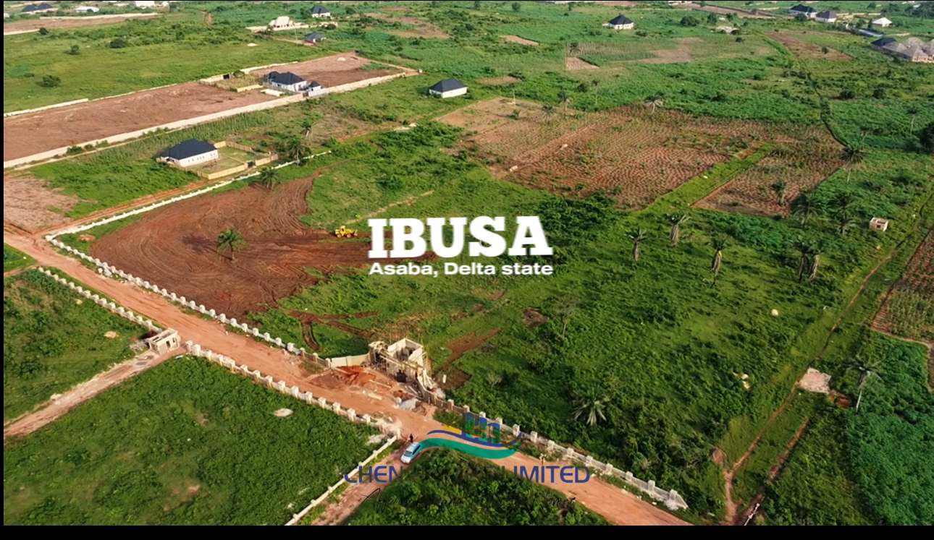
5. Availability Of Land
Many of the popular districts in Asaba has been developed shifting developments to the outskirts of the city.
Favour City Ibusa, Asaba provides you with the opportunity to invest in the growing city of Asaba. Only 150 plots are available for sale currently. Hurry before it’s sold out.

Slide 7
6. Rental Income:
With the growing population and limited housing supply, rental income is relatively high.
This presents a lucrative for investors to invest in Favour City Ibusa and earn passive income through rental properties.

Slide 8
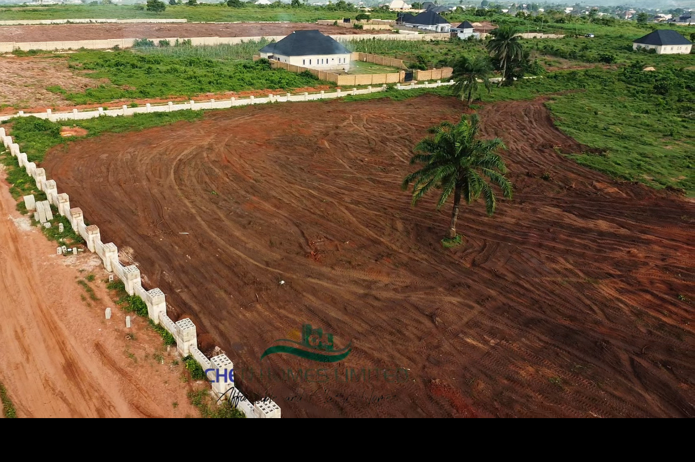
7. Land Topography:
Favour City Ibusa, is a table land and excellent for any kind of structure.
Building in the estate will be relative affordable because the land is not water logged or marshy.

Slide 9
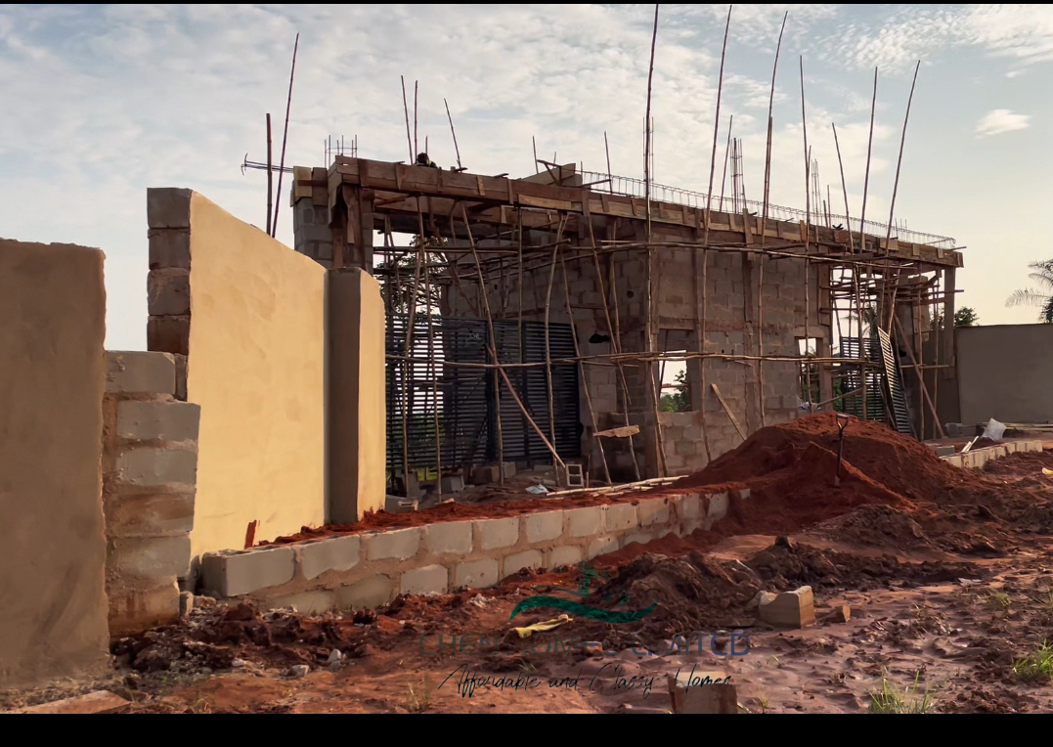
8. Current Infrastructure:
Favour City Ibusa, is a gated estate with comtemporary design.
Frontal fencing have been completed with the perimeter fencing round the whole land ongoing.

Slide 10
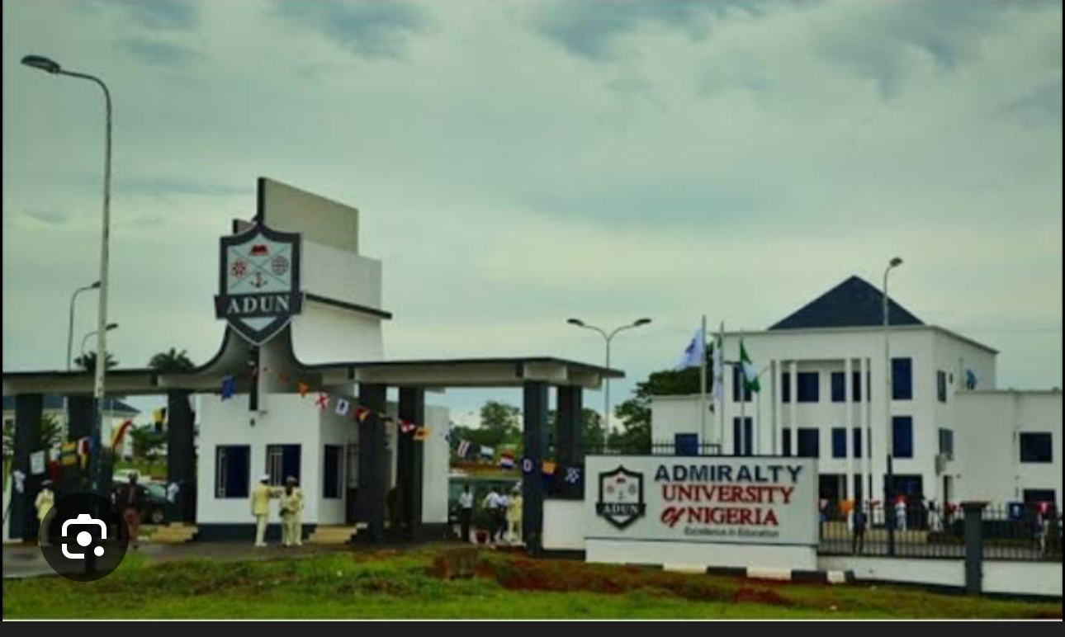
9. Neighbourhood/Location:
Favour City Ibusa, Asaba is at the back of Admiralty University Asaba.
12 minutes drive from Coker roundabout Asaba.
In Isieke Community, Ibusa, Asaba. Delta State
Nigerian Prisons is 5 minutes drive away.
18 minutes drive from Delta State, Govevernment House.
Several other estates.

Slide 11
10. Available Plots Sizes:
Company use: 400sqm
Commercial use: 640sqm (N10.5m Outright)
Subscribers use (Luxury Bungalow): 300sqm
Subscribers Use (Luxury Deplexes and Terraces): 465sqm (50 X 100)

Slide 12
Statutory Fees:
Registered Survey: 500k per plot
DoA. (Deed of Assignment): 200k per plot
Developmental Fee (Road, Drainage and Power): Note yet Determined.
Note: The new prices from August 1st 2025 includes Survey and DoA. This does not include any consideration or discounted subscibers.

Slide 13
Title:
Land Receipt
Survey
CofO under processing

